Slide 1
Surya S S
Final Project
3/21/2024 Annual Review

Slide 2
DeTR: Inference Model
3/21/2024 Annual Review

Slide 3


AGENDA
Problem Statement
Project Overiew
Who are the End Users?
Solution and its Value Proposition
WOW in the Solution
Modelling
Results
3/21/2024 Annual Review

Slide 4

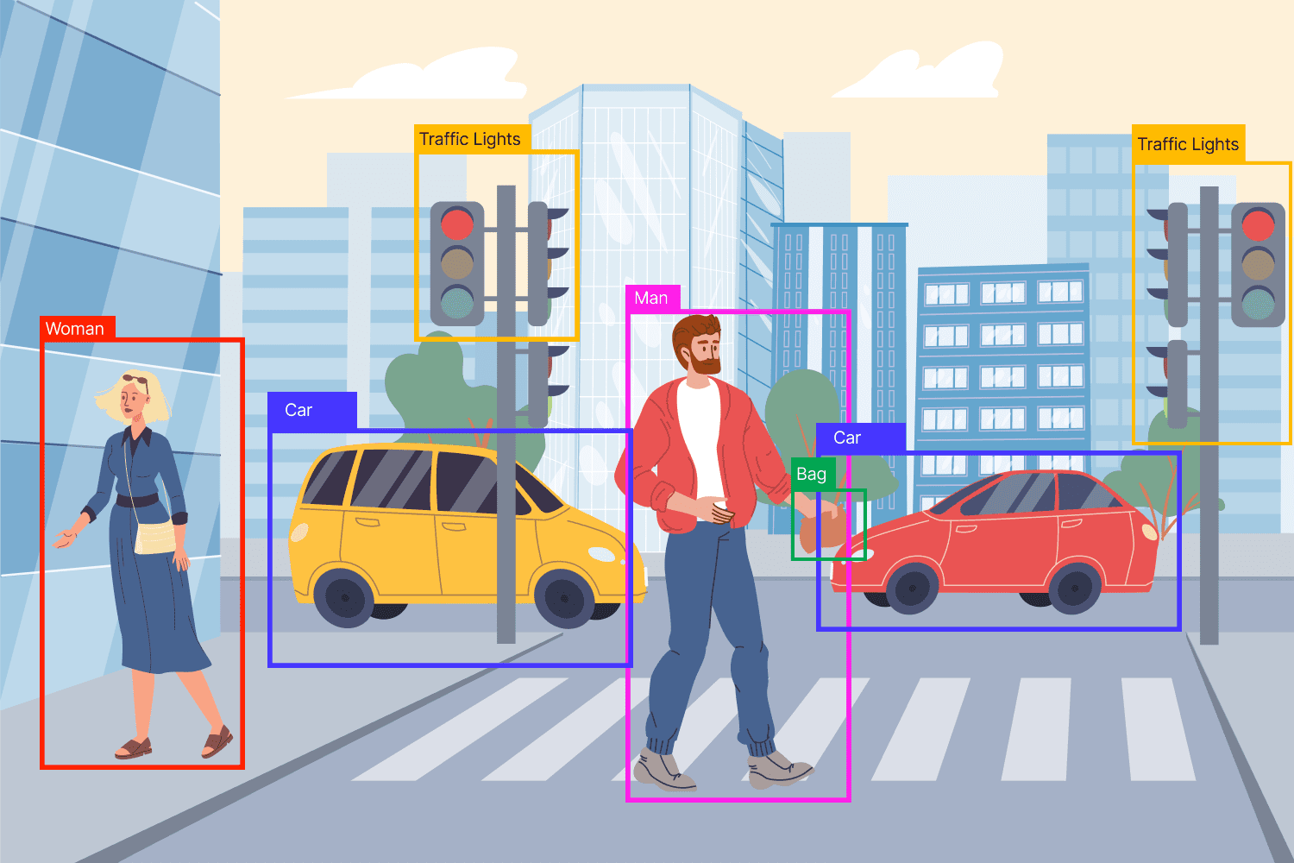
PROBLEM STATEMENT
Our project aims to simplify and enhance object detection using the DeTR inference model. We focus on making detection faster, more accurate, and adaptable to different scenarios, ensuring easy deployment in real-world applications.
3/21/2024 Annual Review

Slide 5

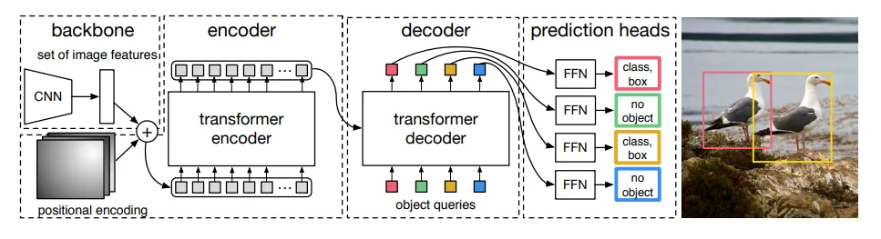
PROJECT OVERVIEW
Introduction:
DeTR is a cutting-edge object detection model based on transformer architecture.
It revolutionizes traditional object detection pipelines by eliminating the need for separate proposal generation and refinement stages.
Architecture:
Consists of an encoder and a decoder, both based on transformer layers.
Encoder processes the input image to generate feature representations.
Decoder generates object queries and utilizes transformer layers to predict class labels and bounding box coordinates for each object directly.
3/21/2024 Annual Review

Slide 6

WHO ARE THE END USERS?
Researchers and Academia:
Researchers and academic institutions using DeTR for advancing studies in computer vision and machine learning.
Technology Companies:
Companies developing autonomous vehicles, surveillance systems, augmented reality, and retail analytics solutions.
Government Agencies and Law Enforcement:
Law enforcement agencies and government bodies utilizing DeTR for surveillance and security purposes.
Healthcare Industry:
Hospitals and medical institutions employing DeTR for medical imaging analysis and diagnosis.
Industrial Sector:
Manufacturing and warehouse management companies integrating DeTR for quality control and inventory tracking.
3/21/2024 Annual Review

Slide 7
SOLUTION AND ITS VALUE PROPOSITION
DeTR Model:
Simplifies object detection using transformers.
Eliminates complexity with end-to-end processing.
Value Proposition:
Efficiency: Faster, streamlined detection process.
Accuracy: Precise object detection results.
Flexibility: Adaptable to different tasks.
Scalability: Handles varying numbers of objects.
Ease of Deployment: Simple integration into existing systems.
3/21/2024 Annual Review

Slide 8
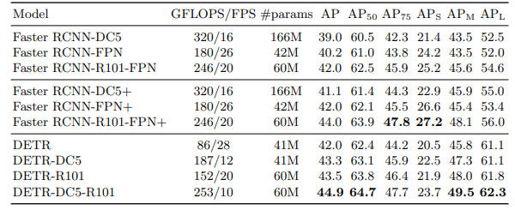

THE WOW IN YOUR SOLUTION
Revolutionary Approach:
DeTR transforms object detection with its innovative use of transformers, streamlining the process and eliminating complexity.
Efficiency Redefined:
Experience lightning-fast object detection with DeTR's end-to-end processing, saving valuable time and resources.
Pinpoint Accuracy:
Achieve unparalleled precision in object detection results, ensuring confidence in decision-making and analysis.
3/21/2024 Annual Review

Slide 9
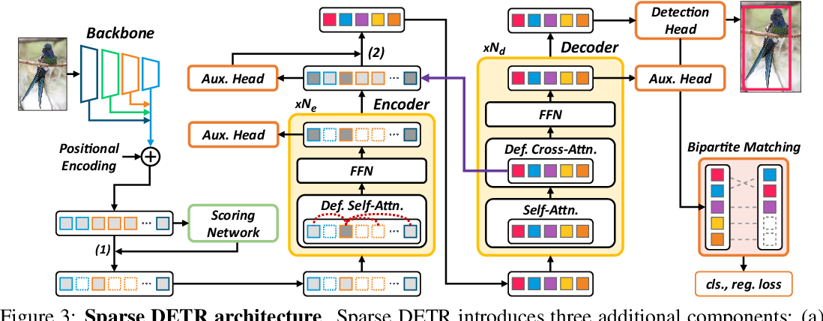
MODELLING
Approach:
Utilize transformer-based architecture for object detection modeling.
Employ encoder and decoder layers to process input images and generate object detections.
Architecture:
Transformer-based encoder processes input images to extract features.
Decoder generates object queries and predicts class labels and bounding box coordinates.
Training:
Train the model using annotated datasets to learn to detect objects in images.
Optimize model parameters to improve accuracy and generalization.
Evaluation:
Evaluate the model's performance using metrics such as precision, recall, and mean average precision (mAP).
Assess accuracy, speed, and efficiency on validation and test datasets.
Validation:
Validate the model's performance on unseen data to ensure generalization and robustness.
Monitor for overfitting and adjust model architecture or training strategy as needed.
3/21/2024 Annual Review

Slide 10
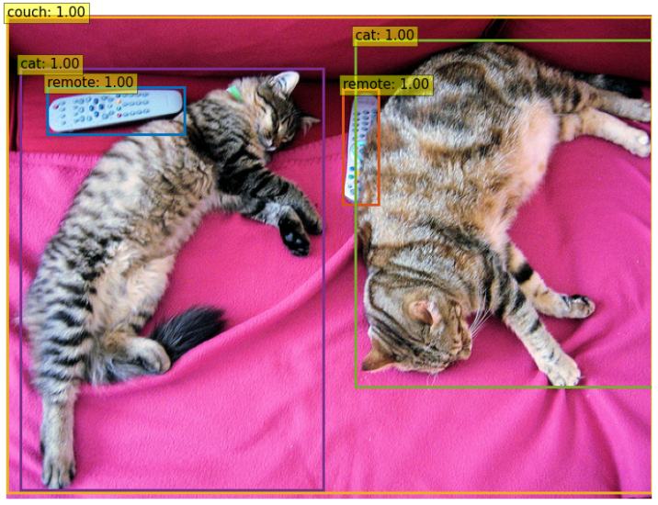
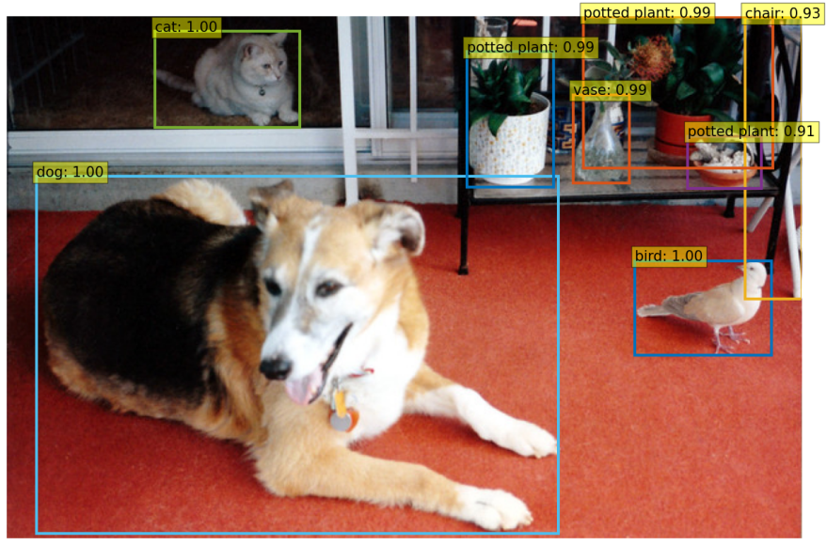
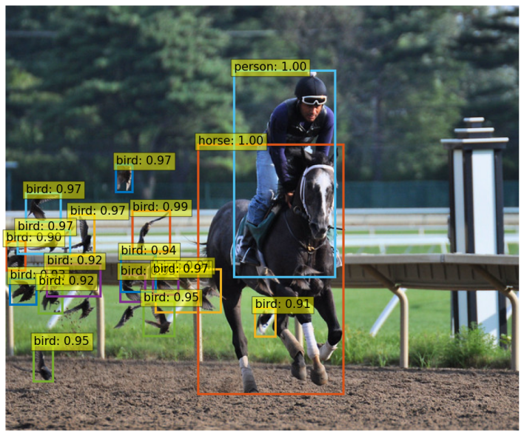
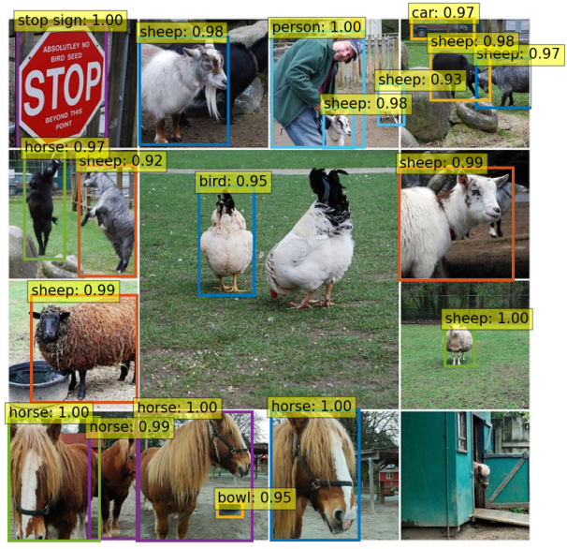
RESULTS
https://github.com/SuryaCreatX/TNSDC-DETR
3/21/2024 Annual Review

